Slide 1
Introduction to Information System
Section 1

Slide 2
Github
GitHub is a website and cloud-based service that helps developers store and manage their code, as well as track and control changes to their code, mainly used for:
Version control
Git

Slide 3
Version Control
Version control helps developers track and manage changes to a software project’s code. As a software project grows, version control becomes essential.
Branching, a developer duplicates part of the source code. The developer can then safely make changes to that part of the code without affecting the rest of the project.
Then, once the developer gets his or her part of the code working properly, he or she can Merge that code back into the main source code to make it official.
All of these changes are then tracked and can be reverted if need be.

Slide 4
Git
Git is a specific open-source version control system created by Linus Torvalds in 2005.
Git is a distributed version control system, which means that the entire codebase and history is available on every developer’s computer, which allows for easy branching and merging.

Slide 5
Create Github Account
With a personal account on GitHub, you can import or create repositories, collaborate with others, and connect with the GitHub community.
To create a personal Github account:
Navigate to https://github.com/ and follow the prompts.
Create a strong and unique password.
Choose GitHub Free account
verify your email address
Configure two-factor authentication
View your GitHub profile and dashboard

Slide 6
Git Bash
Git Bash is an application for Microsoft Windows environments which enables you to interact with Github using a command line called “Bash”.
Git Bash is a package that installs Bash, some common bash utilities, and Git on a Windows operating system.
You can download it from: https://git-scm.com/downloads

Slide 7
Git for Desktop
GitHub Desktop is an application that enables you to interact with GitHub using a GUI instead of the command line or a web browser.
You can use GitHub Desktop to complete most Git commands from your desktop with visual confirmation of changes.
You can push to, pull from, and clone remote repositories with GitHub Desktop, and use collaborative tools.
Go to https://desktop.github.com/, download and install it.

Slide 8
Git Commands
git version: to check the version of the Git installed on your machine.
git init to initiate a local repository of the project.
git status to show modified files in working directory, staged for your next commit (the red files and folders are not committed to the repo).

Slide 9
Git Commands
git add <filename> : to add the files to the staged area.
git add *: to add all files.
Now if we make a little change in any file and save it and type checked the status again, we can see the modified files with red so add them again by (git add . ).

Slide 10
Git Commands
To upload your project to GitHub, First u need to authenticate yourself to Git bash/desktop
Git config--global user.name "user-name“
Git config--global user.email mail@gmail.com
Git commit –m “first Commit”
Now your project ready to be uploaded to the remote repository
Go to the remote repository and get the link
Then, we need to link the local repo to the remote repo, using this command:
git remote add origin https://github.com/testname/repoName.git
git push -u origin master: To push the project to the remote repository.

Slide 11
Git Commands
Now Go To the branch that we have created, and we can see all files of our test program uploaded successfully.
git clone https:// github.com/testname/repoName.git : to clone the repo to our local device to work with it this called (clone it).
git checkout –b name: To make another branch

Slide 12
File Handling in C++
File are used to store data in a relatively permanent form (e.g., on Hard disk, or other form of secondary storage).
Files can hold huge amounts of data if need.
For achieving file handling, we need to follow the following steps:
Create a Handler Object
Naming a file
Opening a file
Writing data into the file
Reading data from the file
Closing a file.

Slide 13
Streams in C++
We give input to the executing program and the execution program gives back the output.
Streams: the flow of data in a sequence of bytes.
The input and output operation between the executing program and files are known as “disk I/O operation”.

Slide 14
Classes for File stream operations
Ofstream (output file stream):
is used to create files and to write information to files.
It can be accessed with the insertion operator ”<<“.
It contains open() function with default output mode.
Use the functions put() and write().
ifstream (input file stream):
is used to read information from files.
It can be accessed with the extraction operator ”>>”.
It contains open() function with default input mode.
Use the functions get(), getline(), and read()
Fstream
This class provides support input and output operations.
Use functions from istream and ostream classes

Slide 15
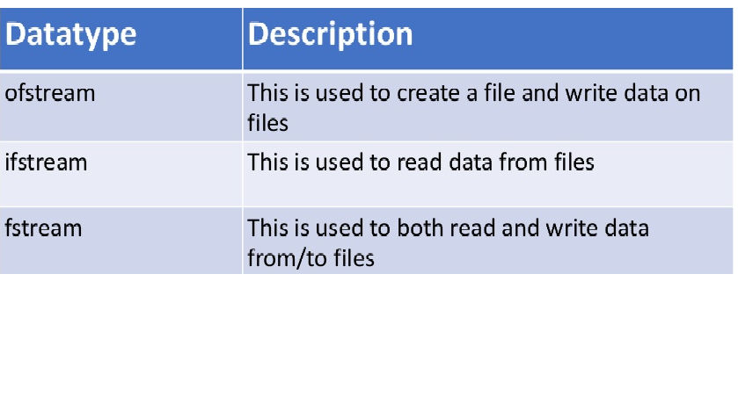

Slide 16
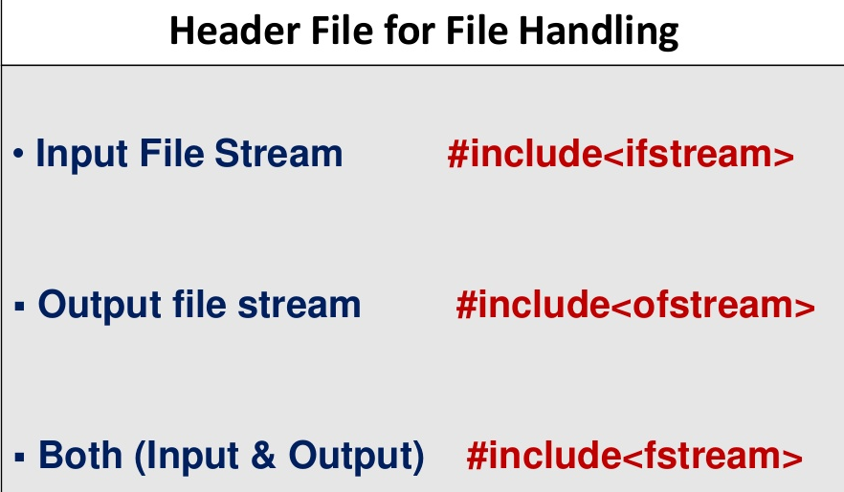

Slide 17
Create file and write text
#include <iostream>
#include <fstream>
using namespace std;
int main () {
ofstream myfile;
myfile.open ("example.txt");
myfile << “Hello world.\n";
myfile.close();
return 0;
}

Slide 18
Reading a text file
#include <iostream>
#include <fstream>
#include <string>
using namespace std;
int main () {
string line;
fstream myfile ("example.txt");
if (myfile.is_open()) {
while ( getline (myfile,line) ) {
cout << line << '\n'; }
myfile.close(); }
else cout << "Unable to open file";
return 0;
}

Slide 19
Writing on a text file using is_open()
#include <iostream>
#include <fstream>
using namespace std;
int main () {
ofstream myfile ("example.txt");
if (myfile.is_open()) {
myfile << "This is a line.\n";
myfile << "This is another line.\n";
myfile.close(); }
else cout << "Unable to open file";
return 0;
}

Slide 20
Writing on a text file
#include <iostream>
#include <fstream>
#include <string>
using namespace std;
int main(){
ofstream fout("test.txt");
if (!fout.is_open())
cout << "File can not be openned\n";
else fout << "Cairo, Damietta, Assiut, Aswan"<<endl;
fout.close();
return 0;
}

Slide 21
Read lines of text file
#include <iostream>
#include <fstream>
#include <string>
using namespace std;
int main(){
ifstream f2;
string line;
int count = 0;
f2.open("example.txt");
while (getline(f2, line)) {
cout << line << endl;
count++; } //end while
cout << "count of lines = " << count << endl;
f2.close();
} //end main

Slide 22
Writing then Reading from a Text File using an Array of String
int main(){
char cities[200] = "Cairo, Damietta, Assiut, Aswan.";
fstream f1;
f1.open("section.txt", ios::out); //Open for writing
if (!f1) { cout << "file can not found\n"; }
else {
for (int i = 0; i < strlen(cities); i++){
f1.put(cities[i]); } }
f1.close();
fstream f2;
string res = "";
f2.open("section.txt", ios::in); //Open for reading
if (!f2) { cout << "file can not found\n"; }
else {
while(!f2.eof()) {
res += f2.get();}}
cout << res << endl;
f2.close();
return 0;
}

